Slide 1
AUGMENTED REALITY BASED APPLICATION TO ENHANCE INTERIOR DESIGNING USING MARKERLESS TRACKING
DOMAIN: MOBILE APPLICATION
BATCH A8
GUIDE:
Mrs Kavitha Subramani
TEAM MEMBERS:
GAYATRI KP (211417104066)
GULLAPALLI LAKSHMI SWARAJ(211417104071)

Slide 2
INTRODUCTION
Augmented reality is a field of computer research which deals combination of reality with computer related data
Earlier if users wanted to buy furniture without visiting the shops it was possible but it was not possible to check how the object actually looks in the home. Same goes for the decoration of a hall or a house for an event.
The main purpose of our project is to develop an android application for trying different décor in a virtual way using a mobile which supports AR camera.
This will make it easier for the user to visualize the furniture, décor, color of walls, etc. anything related to the house and thus, the user can make the decisions based on his/her interest.
This system will help the customer to view the décor virtually in real environment before buying the desired object.
This system would let the user try multiple décor virtually without the physical movement of furniture objects and hence saving time and money.

Slide 3
LITERATURE SURVEY

Slide 4
SNO | TITLE | YEAR | AUTHOR | CONCEPT | TECHNIQUE | FUTURE SCOPE | DRAWBACKS
1 | ANALYSIS AND STATUS QUO OF SMARTPHONE-BASED INDOOR LOCALIZATION SYSTEMS | 2017 | KALYAN P. SUBBU, CHI ZHANG | Indoor localization has been a topic of interest for both the academic and industrial communities. The need for location estimation, fueled mainly by inaccuracies of GPS indoors, has been addressed by specifically designed systems achieving a high localization accuracy but with a high deployment cost. This article takes up the goal of surveying state-of-the-art smartphone based indoor localization systems with critical analysis on their properties such as accuracies across various sensor designs, energy consumption and computational cost | .Analysis of existing indoor localization | The limitations are analysed for the future way of execution

Slide 5
SR NO | TITLE | YEAR | AUTHOR | CONCEPT | TECHNIQUE | FUTURE SCOPE | DRAWBACKS
2 | Sustainable Consumerism via Self-regulation | 2016 | Johannes Klinglmay, Bernhard Bergmair, Evangelos Pournara | In this paper we introduce a new concept of how individual consumers can follow their own understanding of sustainability, while at the same time benefiting from collective and participatory actions. We discuss how the means of ICT can be used to develop political consumerism further to transform individual policies into collective statements. | ASSET platform is used to track the customers consumerism | With this concept we build upon the intrinsic motivation of the individual consumer and at the same time facilitate self-regulation among consumers towards a sustainable consumerism. | Useful for analysing the consumerism. Cannot be used for real time implementation

Slide 6
SNO | TITLE | YEAR | AUTHOR | CONCEPT | TECHNIQUE | FUTURE SCOPE | DRAWBACKS
3 | Rendering Optimization for Mobile Web 3D Based on Animation Data Separation and On-Demand Loading | 2020 | LIANG LI , XIUQUAN QIAO | The existing WebGL 3D JavaScript libraries for Web-based mobile 3D (represented by three.js and babylon.js) load the entire model file at once, large-size 3D models with complex interactions cannot be rendered smoothly due to limited data transmission, the weak computation capabilities of mobile Web browsers, and the latency of 3D model rendering. In this paper, we first propose model-animation data separation and an on-demand loading mechanism to improve the data request and loading process of Web 3D models. | Augmented Reality in 3D modelling | we will focus mainly on preloading large-data volume animations using context-aware methods and a collaborative rendering method based on mobile edge servers and cloud servers | Dealing with 3D models comes with high computation cost.

Slide 7
SNO | TITLE | YEAR | AUTHOR | CONCEPT | TECHNIQUE | FUTURE SCOPE | DRAWBACKS
4 | A Hybrid Smartphone Indoor Positioning Solution for Mobile | 2012 | Jingbin Liu , Ruizhi Chen | Smartphone positioning is an enabling technology used to create new business in the navigation and mobile location-based services (LBS) industries. This paper presents a smartphone indoor positioning engine named HIPE that can be easily integrated with mobile LBS. HIPE is a hybrid solution that fuses measurements of smartphone sensors with wireless signals. | Location based services, hidden Markov model | the system will mitigate the risk of overfilled bins and unsanitary conditions that are caused by the lack of information that is present in the current collection process. | In the future, other smartphone sensors, such as cameras and gyroscopes, will be integrated with HIPE to measure MDI.

Slide 8
SNO | TITLE | YEAR | AUTHOR | CONCEPT | TECHNIQUE | FUTURE SCOPE | DRAWBACKS
5 | A Transitional AR Furniture Arrangement System with Automatic View Recommend ation | 2016 | Mami Mori, Jason Orlosky, Kiyoshi Kiyokawa, Haruo Takemura | Subjects were first asked to memorize a furniture layout presented on a desktop monitor. They were allowed to examine and manipulate the 3D model using a mouse for as long as they wished. Once satisfied, they wore the video see-through headset and used a game pad to place the furniture objects based on their memory of the scene. | Augmented Reality for visualization. | a transitional AR furniture arrangement system that recommends a secondary view that can improve a user’s understanding of a room layout | It is desktop based application ands needs stereo camera and should be placed at minimal and marker based.

Slide 9
SNO | TITLE | YEAR | AUTHOR | CONCEPT | TECHNIQUE | FUTURE SCOPE | DRAWBACKS
6 | Approach to The Interior Design using Augmented Reality Technology | 2015 | Jiang Hui | AR can provide a vivid view (direct or indirect view) of the physical world where elements are enhanced by computer-generated files such as video, graphics, sound, images, or other kind of digital data. This technology is applied to allow a person (the designer, the manufacturer, and the consumer) to combine real and virtual information and objects in a physical, realworld environment. | To analyze and evaluate the impact of Augmented Reality Technology in interior design. The research context is associated at the consumers perception of the project in the management and execution of the interior design. | interior design can reduce the cost and provide the multimedia augmentation of high vivid simulations for user in real time | Requires huge amount of information and quality of object is low.

Slide 10
SNO | TITLE | YEAR | AUTHOR | CONCEPT | TECHNIQUE | FUTURE SCOPE | DRAWBACKS
7 | Use of Augmented Reality in furniture industry | 2015 | Elizabeth Carvalho, Gustaava Macaes, Isabel Varajao, Nuno Sousa, Paulo Brito | a configurable and modular platform that has been developed to solve this gap between the designer's and the client's visual models. It offers an immersive preview of the interior decoration, customizable to the spatial real world visualization area having Augmented Reality (AR) as its technological background | Use of Augmented Reality in furniture industry | Use Simultaneous Localization and Mapping (SLAM) that helps in fixing to rigid body | Marker based and can be placed only on the predefined images.

Slide 11
SNO | TITLE | YEAR | AUTHOR | CONCEPT | TECHNIQUE | FUTURE SCOPE | DRAWBACKS
8 | Virtual Furniture Using Augmented Reality | 2016 | Snehal Mangale, Nabil Phansopkar, Safwaan Mujawar, Neeraj Singh | “Virtual Furniture Using Augmented Reality” which is a web based application where user, have to place the marker in a room where they want to try out furniture items. The user’s webcam will be on and through the webcam they will capture the live feed of the room. Application captures the image and passes through predefined marker detection algorithm. Algorithm is based on image processing techniques using color and other properties as the input to detect the marker. | Web based Application for trying out furniture. | It is faster in image capturing and provide high resolution for furniture 3D model | It is based on personal computer webcam and every time the captured image is to be loaded into web application for processing

Slide 12
PROBLEM STATEMENT
The main purpose of the system is to develop an android application for trying different furniture in a virtual way using a mobile which has a camera that supports AR.
The application will eradicate the human efforts of physically visiting the furniture stores which is a very time-consuming activity.
Besides this, it might be easier to use this technology in online shopping such that the user gets to try the variety of furniture items in their room or house that they wish to purchase and allowing the user to visualize the room as to how it will look after placing the desired furniture in it.
By developing an augmented reality application that allows us to imagine the furniture in the appropriate arena, we hope to improve time efficiency and increase accessibility to the furniture that can be tried on.
To create our proposed system, we make use of applications such as Unity 3D, Vuforia, and Android Studio.
The proposed framework relies on marker-less Augmented Reality to improve user experience and perception.
Marker-less tracking is a spatial tracking technique that allows us to determine an object's location and orientation within a given context.
The basic idea of the proposed system is to place the digital 3D models on the top of real things using a camera.

Slide 13
TECHNOLOGY STACK
SOFTWARE REQUIREMENTS
LANGUAGE | C#
OPERATING SYSTEM | Android 8.0 or more
TOOLS | Unity 3D, Vuforia, Android Studio
HARDWARE REQUIREMENTS
RAM CAPACITY | 4GB
MEMORY | 120 MB
GRAPHICS CARD | 1 GB
ACCESSORIES | SMART PHONE WITH AR SUPPORT

Slide 14
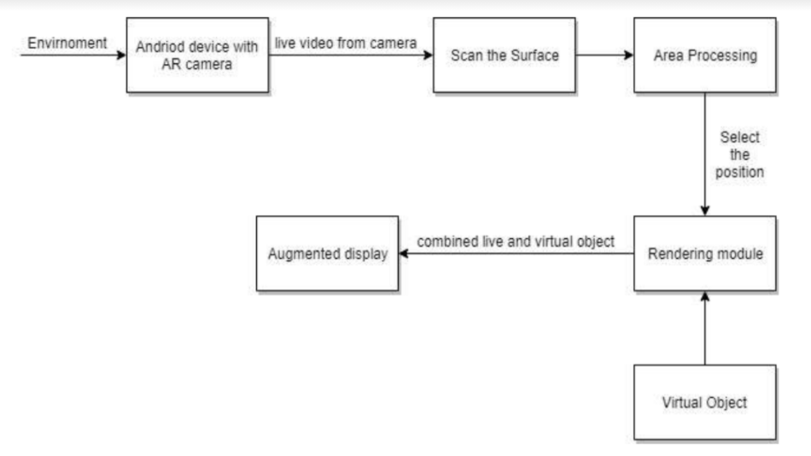
SYSTEM ARCHITECTURE

Slide 15
UML DIAGRAMS

Slide 16
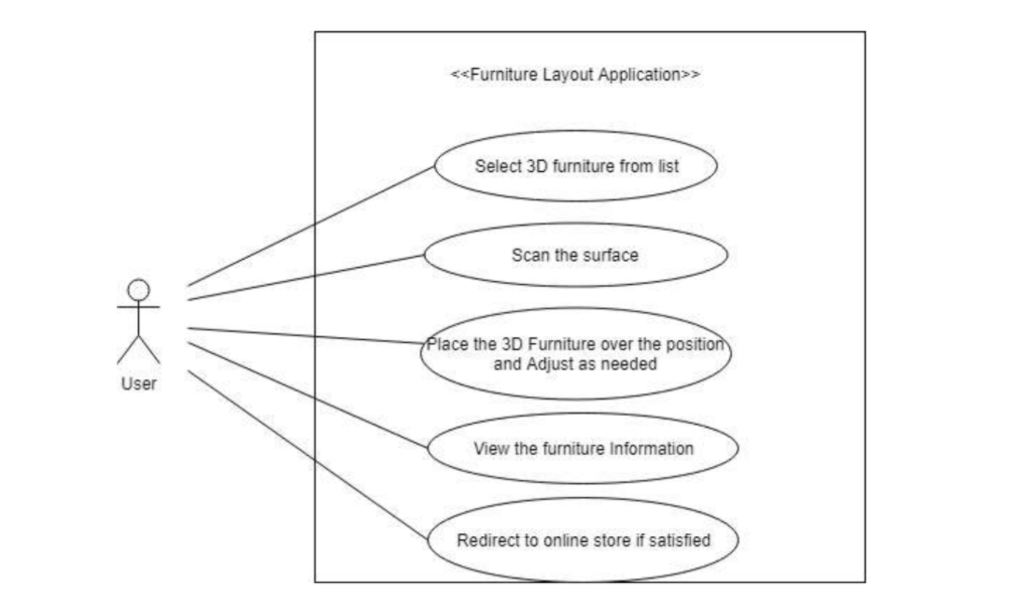
USE CASE DIAGRAM

Slide 17
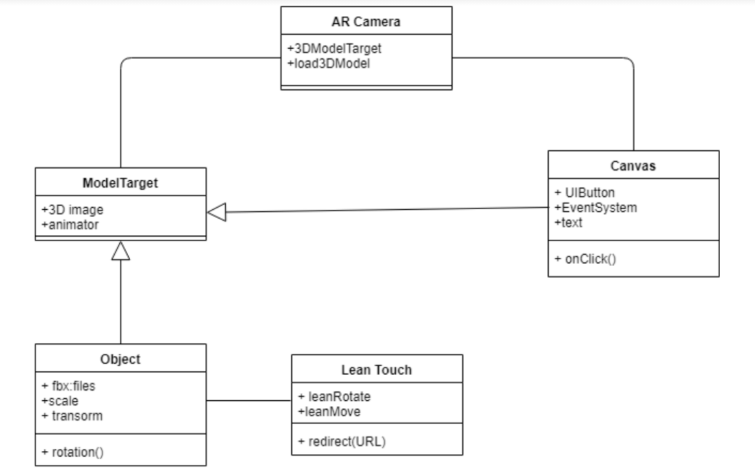
CLASS DIAGRAM

Slide 18
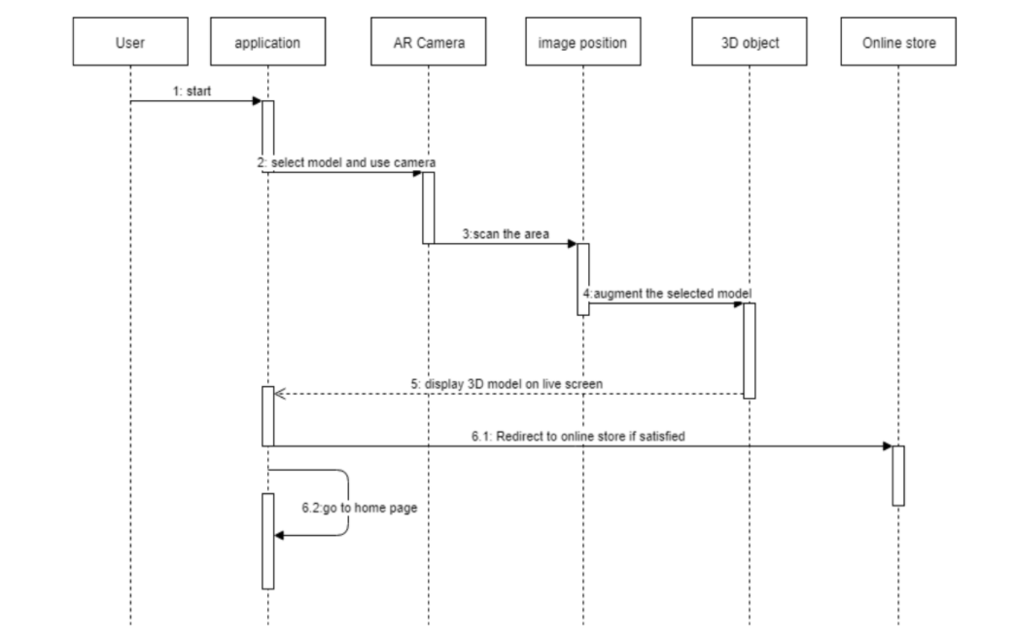
SEQUENCE DIAGRAM

Slide 19
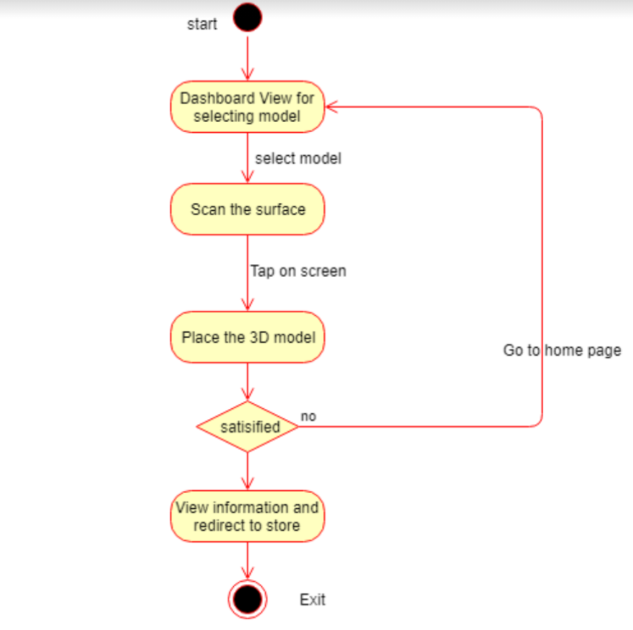
ACTIVITY DIAGRAM

Slide 20
MODULES
The application implementation consists of the following four modules:
Creation of 3D objects using unity 3D.
The environment scanned gets fixed as the target image.
Placing the virtual 3D objects on the surface area.
Verification of the placed objects.

Slide 21
MODULE DESCRIPTION
CREATION OF 3D OBJECTS USING UNITY 3D
Unity 3D has custom resources and in built packages for augmented reality creations.
Using this platform we create 3D models that is required for our Augmented Reality
ENIVRONMENT SCANNED AS A TARGED
For this project Android studio is used with the Vuforia package.
Vuforia packages is used because it offers 3D model demonstrations, to create applications for customers to personalize their products and gives a robust AR experience with the vision technology.
The surface gets scanned as a target image and gets stored in the Vuforia cloud, on this scanned surface the 3D image which we want to place over the surface can be now placed.

Slide 22
MODULE DESCRIPTION
PLACING THE VIRTUAL 3D OBJECTS ON THE SURFACE AREA
After the environment gets scanned, the required furniture piece can be selected from the given list which is the form a button.
The button with the 3D image has been created using the user interface package available in Unity 3D.
As soon as we click on the button of the required 3D image, it gets augmented over the environment which is currently acting as a target variable which has already been rendered in the previous module and been stored in the Vuforia cloud.
VERIFICATION OF PLACED OBJECTS
Once the user thinks that the object is well suited to his need, he can check the description and buy that product accordingly.

Slide 23
TESTING
Functional Testing
SR NO | ACTION | EXPECTED RESULT | ACTUAL RESULT | Final Result
1. | Add image target in the Hierarchy | Image target added to the hierarchy. | Image target added to the hierarchy. | Pass
2. | Press play button to see the animation | Animation can be seen. | Animation can be seen. | pass
3. | Opening software to make a new AR scene | Software was able to be opened. | Software was able to be opened. | pass
4. | Changing scene from one level to another level | Scenes could be changed. | Scenes could be changed. | pass
5. | Press the button to play the object | Object was played. | Object was played | pass

Slide 24
TESTING
SR NO | ACTION | EXPECTED RESULT | ACTUAL RESULT | Final Result
6. | Tap to place the 3D object | 3D object is placed. | 3D object is placed. | pass
7. | Rotating the 3D object in clock wise direction | Rotation successful. | Rotation successful. | pass
8. | Changing the scene from one mode to another mode | Changing of scene from one mode to another mode was successful. | Changing of scene from one mode to another mode was successful. | pass
9. | Building app. | App has been built. | App has been built. | pass
10. | Open the application and target the 3D model | Application runs successfully. | Application runs successfully. | pass

Slide 25
PERFORMANCE ANALYSIS
The image target gets successfully added in the hierarchy.
The unity software has a few troubles while initializing the software but is manageable.
Once the unity 3d is opened the scenes are successfully created and run.
Rotating the objects and scene changing is successfully implemented.
We build an app which enables us to augment our 3D images successfully in the real world environment.
Time taken for :
a. Initializing – 60 seconds
b. Actual Output – 10 seconds

Slide 26
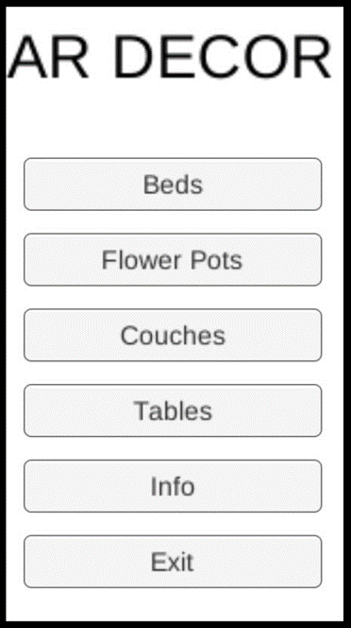
RESULTS
The following are the outcomes of our proposed system:
A.
This is the home page of our app and it consists of five sections of varied furniture pieces: Beds, Flower Pots, Couches, Tables and Information.

Slide 27
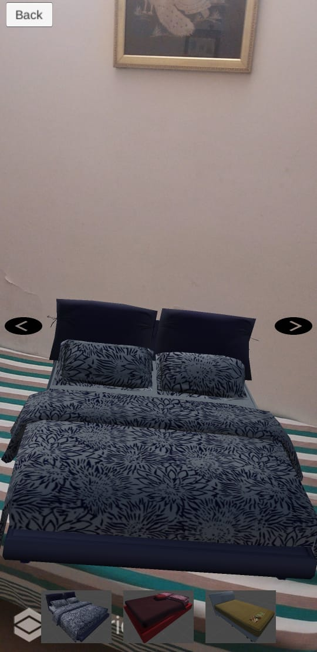
BED 3D IMAGE
B.
The 3D image of the Bed has been successfully positioned on the target image and now we can check if it fits in our home set up. We can rotate the sofa using the arrows provided and there are 3 options of beds where we can choose from.

Slide 28
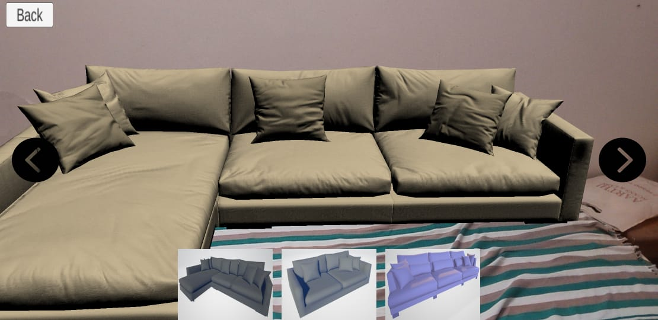
L-SHAPED 3D IMAGE
C.
The 3D image of the L shaped sofa has been successfully positioned on the target image and now we can check if it fits in our home set up. We can rotate the sofa using the arrows provided and there are 3 options of sofas where we can choose from.

Slide 29
CONCLUSION
The main objective of our project is to analyze the use of augmented reality to render the furniture in real world.
Augmented reality technology that allows the customers to decide and interact the chosen furniture with the real world, offering new possibilities for furniture online shopping.
This helps the buyer in determining how to setup the furniture in their home structure.
Augmented reality is new evolving technology in the field of computer science and will make us much more helpful than the traditional technologies

Slide 30
REFERENCES
[1] C. Woodward, T. Kuula, P. Honkamaa, M. Hakkarainen, and P. Kemppi,“Implementation and evaluation of a mobile augmented reality systemfor building maintenance,” in Proc. 14th Int. Conf. Construct. Appl.Virtual Reality, 2014, pp. 306–315.
[2] H.-L. Chi, S.-C. Kang, and X. Wang, “Research trends and opportunitiesof augmented reality applications in architecture, engineering,and construction,” Autom. Construct., vol. 33, pp. 116–122,Aug. 2013.
[3] X. Wang, M. J. Kim, P. E. D. Love, and S.-C. Kang, “Augmented realityin built environment: Classification and implications for future research,”Autom. Construct., vol. 32, pp. 1–13, Jul. 2013.
[4] D. Casale, “Project Lion—A DPR/trimble automated layout robot,”in Proc. ENR FutureTech. San Fransisco, CA, USA: McGraw-Hill,Mar. 2013. [Online]. Available: https://www.youtube.com/watch?v=klfL3dA1SEand https://goo.gl/wZviQe
[5] J. M. Prouty, “Robotic construction site marking apparatus,”U.S. Patents 471 883, Nov. 21, 2013.
[6] Trimble. Trimble RTS Series Robotic Total Stations. Accessed: Feb. 24,2019. [Online]. Available: https://buildings.trimble.com/layout/rts
[7] S. Lee and Ö. Akin, “Augmented reality-based computational fieldworksupport for equipment operations and maintenance,” Autom. Construct.,vol. 20, no. 4, pp. 338–352, 2011.
[8] R. Sacks, C. M. Eastman, G. Lee, and P. Teicholz, BIM Handbook:A Guide to Building Information Modeling for Owners, Designers,Engineers, Contractors, and Facility Managers, 3rd ed. Hoboken, NJ,USA: Wiley, 2018.
[9] O. Bimber and R. Raskar, Spatial Augmented Reality: Merging Real andVirtual Worlds. Boca Raton, FL, USA: CRC Press, 2005.
[10] G. Cortes, E. Marchand, G. Brincin, and A. Lécuyer, “MoSART: Mobilespatial augmented reality for 3D interaction with tangible objects,” Front.Robot. AI, vol. 5, p. 93, Aug. 2018.
[11]Megha Trivedi, Karan Chaure, Saihita Ajgaonkar, Akshay Chimkar. (2021, Apr.). Home Interior Using Augmented Reality. International Journal of Advanced Research in Computer and Communication Engineering. [Online]. Vol. 10, Issue 4, April 2021 DOI 10.17148/IJARCCE.2021.10478. Avaialble: https://ijarcce.com/wp-content/uploads/2021/05/IJARCCE.2021.10478.pdf
[12]P. S. Toke , Aditya Limaye , Susmit Mane , Vishal Metri , Aniket Paste.(2016, Jan.). Augmented Panorama for Furniture Layout. International Journal of Advanced Research in Computer and Communication Engineering [Online]. Vol. 5, Issue 1, January 2016. ISSN (Online) 2278-1021 ISSN (Print) 2319 5940. Available: https://ijarcce.com/wp-content/uploads/2016/02/IJARCCE-85.pdf

Slide 31
THANK
YOU

